Slide 1
How Time and Temperature Affects Rideshare Companies
New York City: 7/1/2014-9/30/2014
March 27, 2018
By Blair, Joana, Jiali

Slide 2
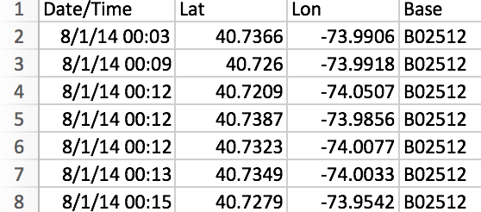
Data Intro
Data sources: Kaggle (Uber Pickups in New York City) and Weather Underground API
Data period: July to September 2014
Data size:
Uber: over 2 million pickups
Lyft: ~250,000 data pickups
Weather: Temperature every hour

Slide 3
Motivation & Summary
Question: Does time of day and temperature affect frequency of rideshare company rides?
Why: We use rideshare companies differently in different conditions.
Hypothesis: Uber and Lyft’s frequency of rides is affected by time of day and temperature
These effects will not be the same for Uber and Lyft
Summary: Uber and Lyft had different peak times and days for ride frequency, and weather had an effect on frequency of Uber rides in New York City

Slide 4
Questions and Data
Are there certain days that people in New York City use ride share services more frequency than others?
Kaggle (Uber and Lyft Pickups in New York City)
Are there more rideshare users during rush hour compared to other times during the day?
Kaggle (Uber and Lyft Pickups in New York City)
How does precipitation affect frequency of uber riders?
Kaggle (Uber Pickups in New York City) & Weather Underground API
How does temperature affect frequency of Uber riders?
Kaggle (Uber Pickups in New York City) & Weather Underground API

Slide 5
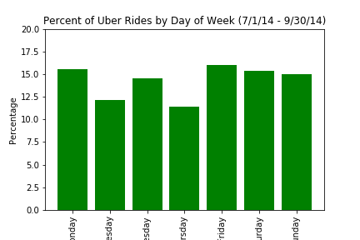
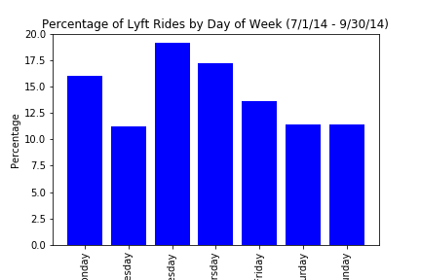
Data Analysis: Day of Week Analysis

Slide 6
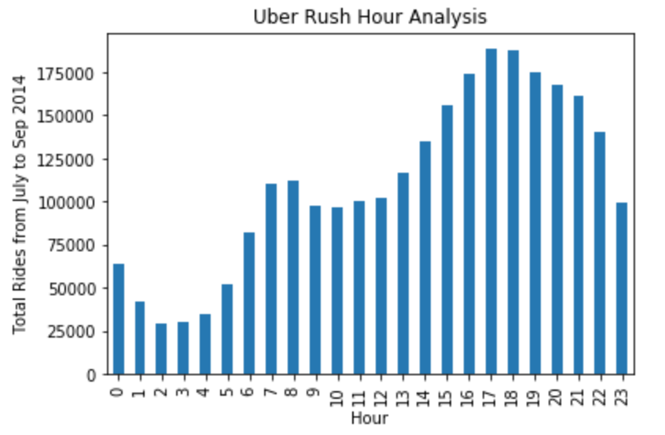
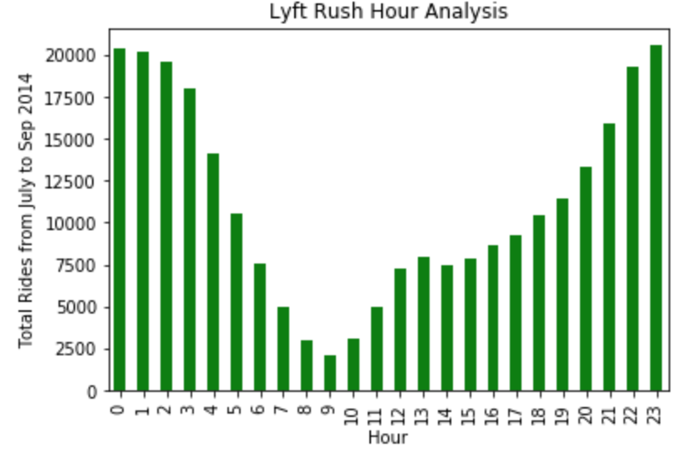
Data Analysis - Rush Hour Analysis

Slide 7
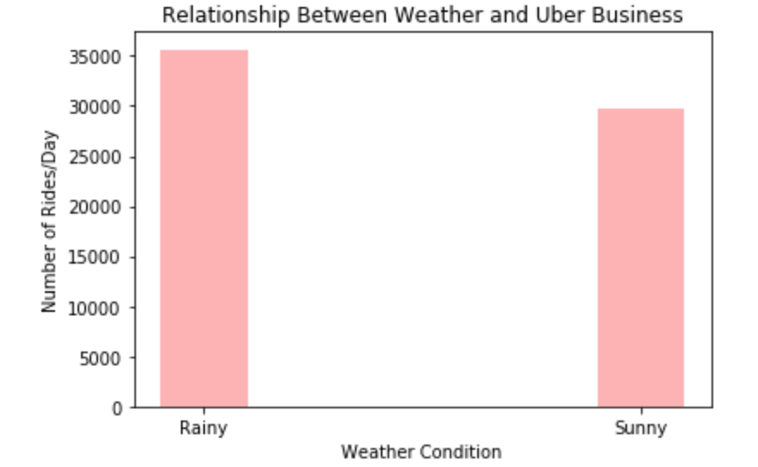
Data Analysis: Precipitation Impacts on Uber

Slide 8
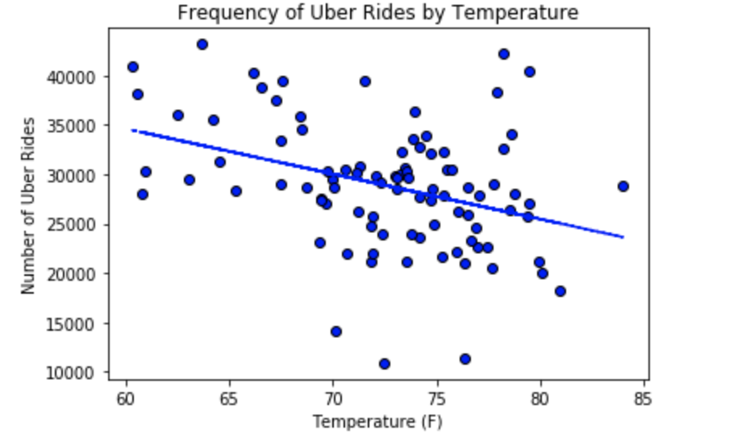
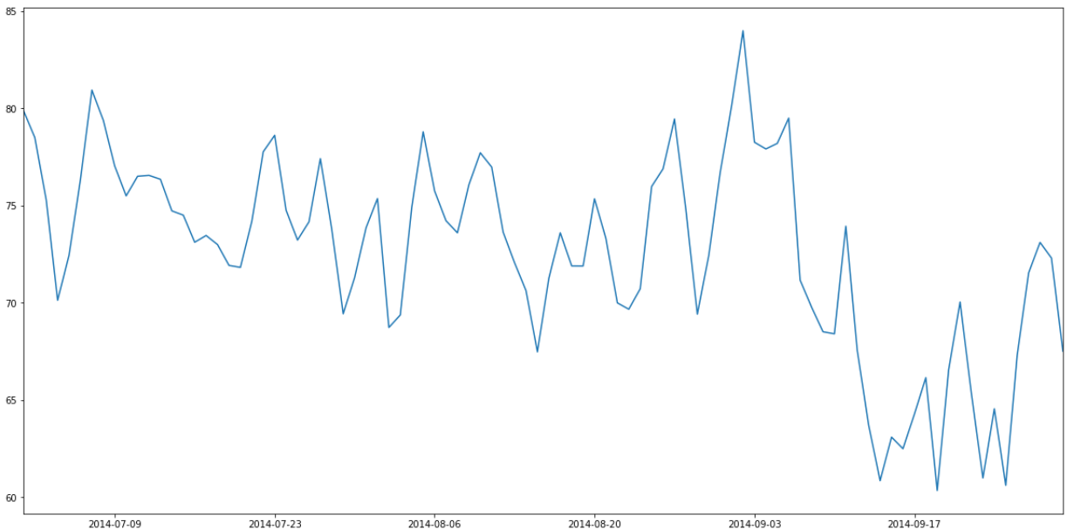
How Weather(temperature) impacts Uber business
How Temperature Affects Uber Ride per Day

Slide 9
Discussion
There are differences in frequency of riders per day between Uber and Lyft in New York City
Uber had similar frequency of riders every day of the week
Lyft had the most riders on Wednesday and least on Saturday and Sunday
Uber and Lyft have different peak hours of ridership in New York City
Uber had the most riders between 5pm- 6pm
Lyft had the most riders between 11pm - 2am
Frequency of Uber rides is higher on rainy days compared to sunny days
As temperature increased frequency of Uber rides decreased

Slide 10

Post Mortem
Challenges:
Not being able to convert Latitude and Longitude to zip-code
Dealing with DateTimes
Limited API calls for historical weather data
Future Directions:
Incorporating price data

Slide 11

Thanks!

